Slide 1

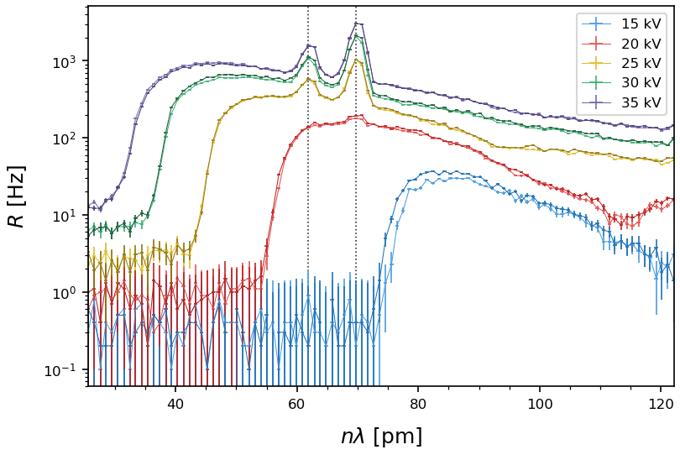
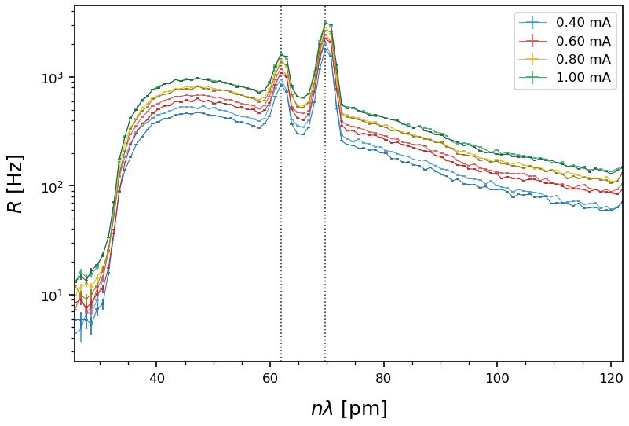
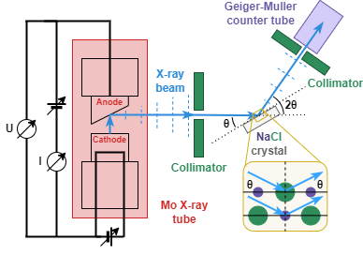
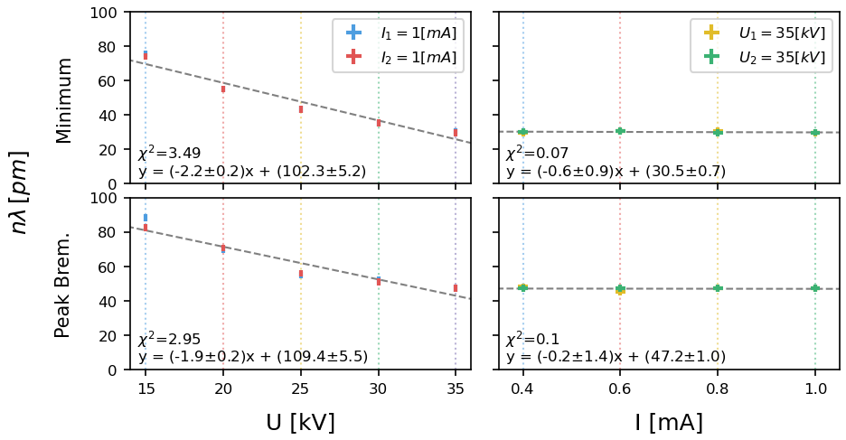
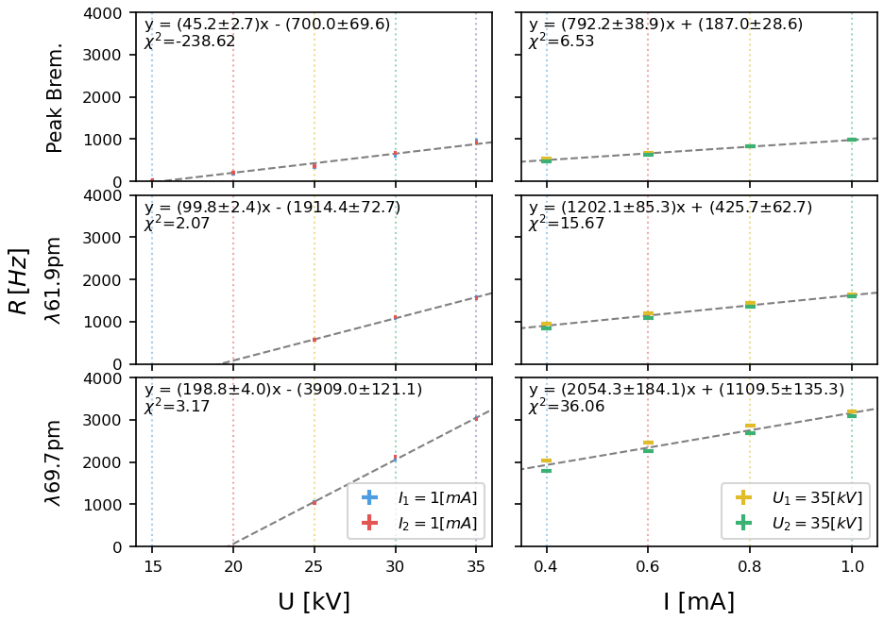
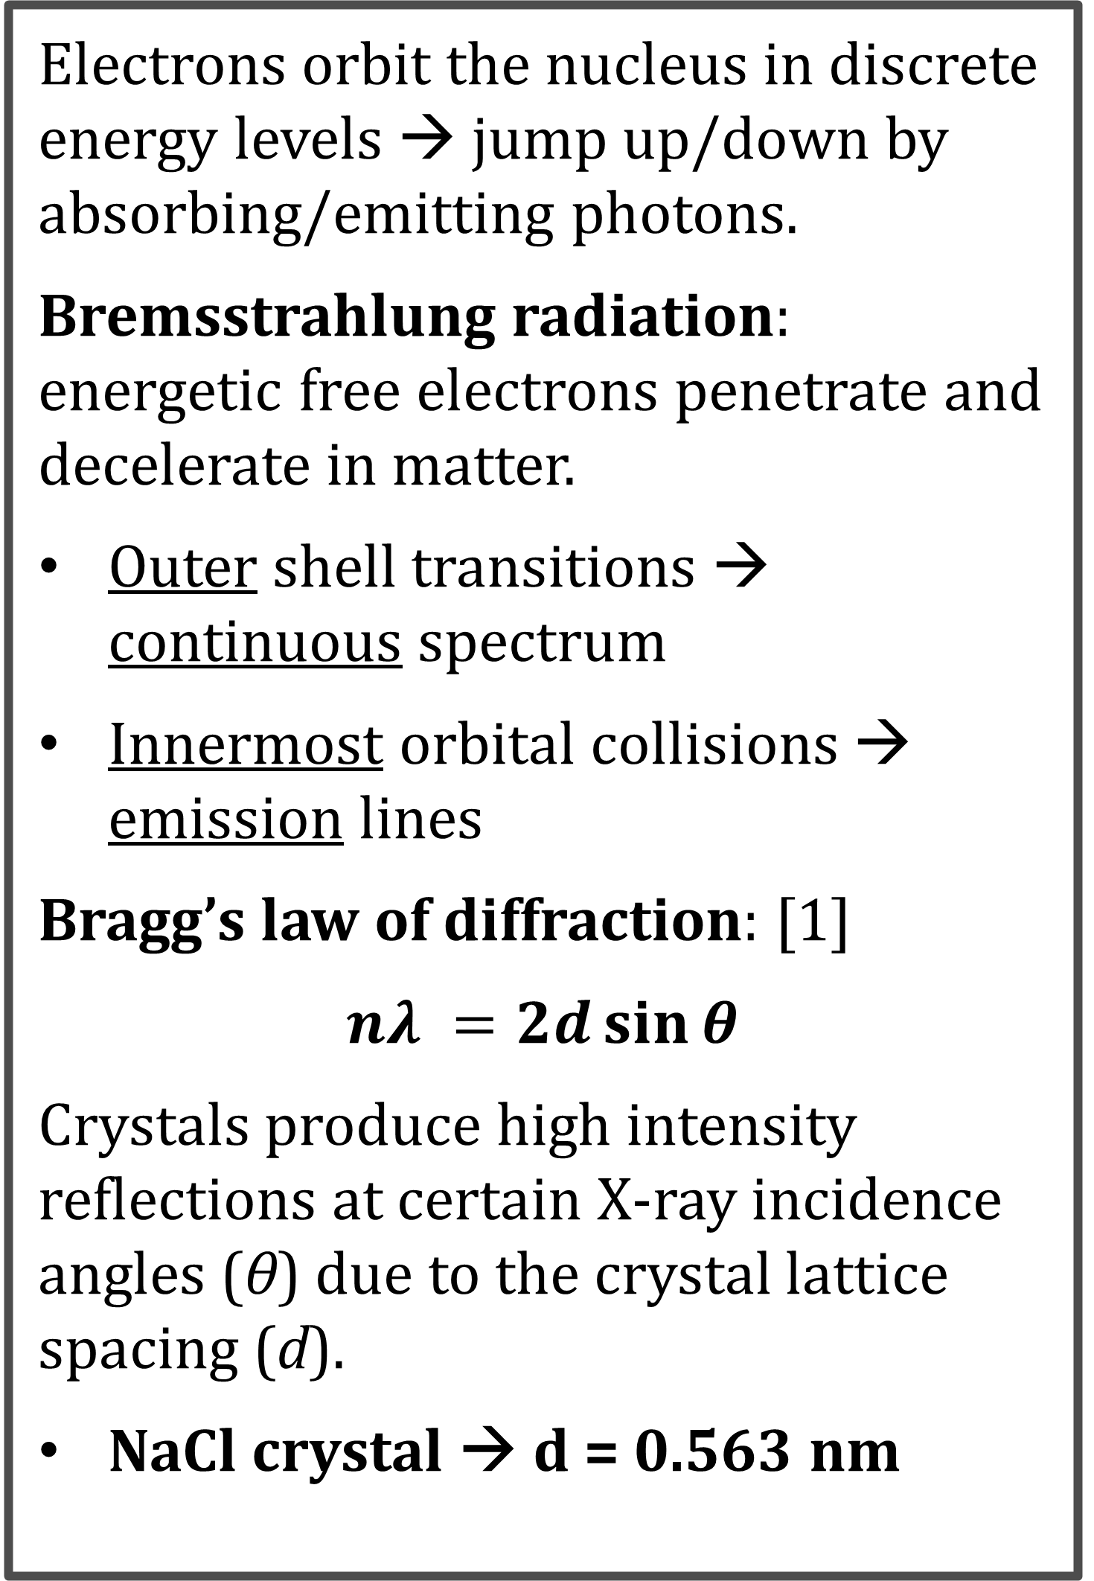
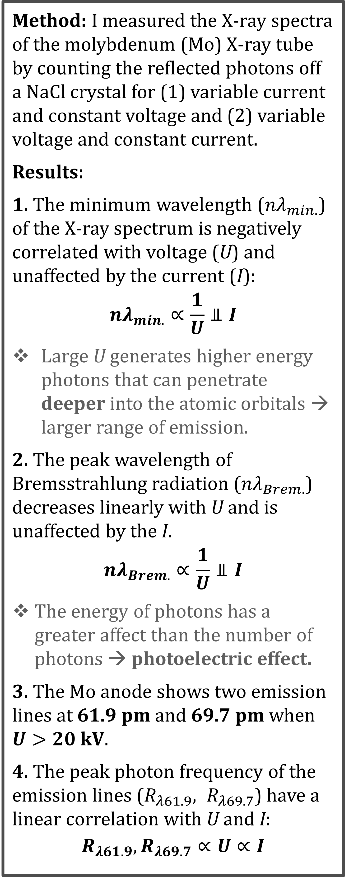




Effects of voltage and current on the
X-ray spectrum of molybdenum
Thresa Kelly & Dr. Michael Murray
Department of Physics & Astronomy, University of Kansas, Lawrence, KS 66045, USA
1. Objective
How does the high voltage (U) and emission current (I) of affect the spectrum of a molybdenum (Mo) X-ray tube?
2. Background
4. Results
5. Conclusions
Electrons orbit the nucleus in discrete energy levels → jump up/down by absorbing/emitting photons.
Bremsstrahlung radiation: energetic free electrons penetrate and decelerate in matter.
Outer shell transitions → continuous spectrum
Innermost orbital collisions → emission lines
Bragg’s law of diffraction: [1]
$$nλ =2d\sin{θ}$$
Crystals produce high intensity reflections at certain X-ray incidence angles (θ) due to the crystal lattice spacing (d).
NaCl crystal → d = 0.563 nm
← Fig 2: Photon count frequency (R) versus wavelength (nλ) for variable voltage
$\text{U} \text{= (}U_{trial}±\text{0}\text{.1}\text{)}$ kV
and a constant current of
$I=(1.00±0.01)$ mA
The emission lines (gray) are at 61.9 pm and 69.7 pm. The spectra changes dramatically with U.
Method: I measured the X-ray spectra of the molybdenum (Mo) X-ray tube by counting the reflected photons off a NaCl crystal for (1) variable current and constant voltage and (2) variable voltage and constant current.
Results:
1. The minimum wavelength (${nλ}_{min.}$) of the X-ray spectrum is negatively correlated with voltage (U) and unaffected by the current (I):
$${nλ}_{min.}∝\frac{1}{U}⫫I$$
Large U generates higher energy photons that can penetrate deeper into the atomic orbitals → larger range of emission.
2. The peak wavelength of Bremsstrahlung radiation (${nλ}_{Brem.}$) decreases linearly with U and is unaffected by the I.
$${nλ}_{Brem.}∝\frac{1}{U}⫫I$$
The energy of photons has a greater affect than the number of photons → photoelectric effect.
3. The Mo anode shows two emission lines at 61.9 pm and 69.7 pm when $U>20$ kV.
4. The peak photon frequency of the emission lines ($R_{λ61.9}, R_{λ69.7}$) have a linear correlation with U and I:
$$R_{λ61.9}, R_{λ69.7}∝U∝I$$
← Fig 3: Photon count frequency (R) versus wavelength (nλ) for variable current
$I=(I_{trial}±0.01)$ mA
and a constant voltage.
$U=\left(35.0±0.1\right)$ kV
The R appears to increase slightly with I.
3. Apparatus
↑ Fig. 1: X-ray beam (blue) generated by Mo X-ray tube (red) is collimated (green) and reflects off NaCl crystal (gray) at angle θ, and then is collimated and detected by the Geiger-Müller counter tube (purple).
Emission current (I) → number of emitted electrons
High voltage (U) → energy of emitted electrons.
Electromagnetic frequency: [2]
$$E=hν=hc/λ$$
→ Fig 4: Minimum (top) and peak Bremsstrahlung (bottom) wavelength (nλ) versus U (left) and I (right).
- The best fit lines (gray) were generated using a least-squares algorithm.
- nλ has a strong negative correlation with U, and a confident no correlation with I.
→ Fig 5: R at the peak Bremsstrahlung (top) and emission lines (bottom) versus U (left) and I (right).
- All parameters appear to increase with both U and I.
- $R_{Brem.}$ is non-linear with U.
- $R_{λ61.9}$ and $R_{λ69.7}$ have a strong U and weak I positive linear correlation.
6. References
Contact: ThresaKelly133@gmail.com
[1] W. H. S. Bragg and W. L. S. Bragg, The reflection of X-rays by crystals, Nature 91, 477 (1913).
[2] M. Planck, Ueber das gesetz der energieverteilung im normalspectrum,
Annalen der Physik 309, 553–563 (1901).
December 2023
Notes:
Peak Bremsstrahlung and emission lines R versus U and I. All parameters appear to increase with both voltage and current.

